Slide 1


Computer Networks
Lectures (Chapter 5)
Network Layer: Control Plan
Subhan Ullah, PhD
subhan.ullah@nu.edu.pk
BS(Computer Science) Fall-2022

Slide 2
Network layer control plane: our goals
understand principles behind network control plane:
  traditional routing algorithms
  SDN controllers

Slide 3

Network layer: “control plane” roadmap
introduction
routing protocols
  link state
  distance vector
Internet Control Message Protocol (already covered…)

Slide 4
Network-layer functions
forwarding: move packets from router’s input to appropriate router output
data plane
routing: determine route taken by packets from source to destination
control plane
Two approaches to structuring network control plane:
per-router control (traditional)
logically centralized control (software defined networking)

Slide 5

Per-router control plane
Individual routing algorithm components in each and every router interact in the control plane
Routing
Algorithm
control
plane
data
plane
values in arriving
packet header
0111
1
3
2

Slide 6
Software-Defined Networking (SDN) control plane
Remote controller computes, installs forwarding tables in routers
Remote Controller
control
plane
data
plane
CA
CA
CA
CA
CA
values in arriving
packet header
0111
1
3
2

Slide 7
Network layer: “control plane” roadmap
introduction
routing protocols
  link state
  distance vector
intra-ISP routing: OSPF
routing among ISPs: BGP
SDN control plane
Internet Control Message Protocol
network management, configuration
  SNMP
  NETCONF/YANG

Slide 8
















Routing protocols
mobile network
Routing protocol goal: determine “good” paths (equivalently, routes), from sending hosts to receiving host, through network of routers
path: sequence of routers packets traverse from given initial source host to final destination host
“good”: least “cost”, “fastest”, “least congested”
routing: a “top-10” networking challenge!
national or global ISP
application
transport
network
link
physical
network
link
physical
network
link
physical
network
link
physical
network
link
physical
network
link
physical
datacenter
network
application
transport
network
link
physical
enterprise
network

Slide 9
Graph abstraction: link costs
5
c_{a,b}: cost of direct link connecting a and b
e.g., c_{w,z} = 5, c_{u,z} = ∞
  cost defined by network operator: could always be 1, or inversely related to bandwidth, or directly related to congestion
v
3
w
2
5
u
2
1
z
3
1
2
x
y
1
graph: G = (N,E)
N: set of routers = { u, v, w, x, y, z }
E: set of links ={ (u,v), (u,x), (v,x), (v,w), (x,w), (x,y), (w,y), (w,z), (y,z) }
aside: graph abstraction is useful in other network contexts, e.g., P2P, where N is set of peers and E is set of TCP connections

Slide 10
Routing algorithm classification
global: all routers have complete topology, link cost info
“link state” algorithms
dynamic: routes change more quickly
  periodic updates or in response to link cost changes
How fast do routes change?
static: routes change slowly over time
decentralized: iterative process of computation, exchange of info with neighbors
routers initially only know link costs to attached neighbors
“distance vector” algorithms
global or decentralized information?

Slide 11
Network layer: “control plane” roadmap
introduction
routing protocols
  link state
  distance vector
intra-ISP routing: OSPF
routing among ISPs: BGP
SDN control plane
Internet Control Message Protocol
network management, configuration
  SNMP
  NETCONF/YANG

Slide 12
Dijkstra’s link-state routing algorithm
centralized: network topology, link costs known to all nodes
  accomplished via “link state broadcast”
  all nodes have same info
computes least cost paths from one node (“source”) to all other nodes
  gives forwarding table for that node
iterative: after k iterations, know least cost path to k destinations
notation
c_{x,y}: direct link cost from node x to y; = ∞ if not direct neighbors
D(v): current estimate of cost of least-cost-path from source to destination v
p(v): predecessor node along path from source to v
N': set of nodes whose least-cost-path definitively known

Slide 13
Dijkstra’s link-state routing algorithm
1 Initialization:
2 N' = {u} /* compute least cost path from u to all other nodes */
3 for all nodes a
4 if a adjacent to u /* u initially knows direct-path-cost only to direct neighbors */
5 then D(a) = c_{u,a} /* but may not be minimum cost! */
6 else D(a) = ∞
7
8 Loop
9
10
11
12
13
14
15 until all nodes in N'
find a not in N' such that D(a) is a minimum
add a to N'
update D(b) for all b adjacent to a and not in N' :
D(b) = min ( D(b), D(a) + c_{a,b} )
/* new least-path-cost to b is either old least-cost-path to b or known
least-cost-path to a plus direct-cost from a to b */

Slide 14
Dijkstra’s algorithm: an example
v
w
x
y
z
Step
0
1
2
3
4
5
N'
D(v),p(v)
D(w),p(w)
D(x),p(x)
D(y),p(y)
D(z),p(z)
u
2,u
5,u
1,u
∞
∞
ux
2,u
4,x
2,x
∞
uxy
2,u
3,y
4,y
uxyv
3,y
4,y
uxyvw
4,y
uxyvwz
Initialization (step 0): For all a: if a adjacent to then D(a) = c_{u,a}
5
find a not in N' such that D(a) is a minimum
add a to N'
update D(b) for all b adjacent to a and not in N' :
D(b) = min ( D(b), D(a) + c_{a,b} )
v
3
w
2
5
u
2
1
z
3
1
2
x
y
1
Notes:
Steps for row 0(Identification) and 1 (update).
D(v) = min ( D(v), D(x) + c_{x,v} ) =min(2, 1+2) = 2
D(w) = min ( D(w), D(x) + c_{x,w} ) = min (5, 1+3) = 4
D(y) = min ( D(y), D(x) + c_{x,y} ) = min (inf, 1+1) =2
Steps for row 2(identification) and 3(update).
D(w) = min ( D(w), D(y) + c_{y,w} ) = min (4, 2+1) = 3
D(z) = min ( D(z), D(y) + c_{y,z} ) = min (inf, 2+2) =4
Steps for 4(identification) and 5(update).
D(w) = min(D(w), D(v)+ c_{v,w} ) = min (3, 2+3) = 3
D(z) = min ( D(z), D(w) + c_{w,z} ) = min (4, 3+5) =4

Slide 15
Dijkstra’s algorithm: an example
5
v
3
w
2
5
u
2
1
z
3
1
2
D(w),p(w)
5,u
4,x
3,y
3,y
x
y
1
resulting least-cost-path tree from u:
resulting forwarding table in u:
v
w
destination
outgoing link
v
x
y
w
z
(u,v)
(u,x)
(u,x)
(u,x)
(u,x)
route from u to v directly
u
z
x
route from u to all other destinations via x
y

Slide 16
Dijkstra’s algorithm: another example
v
w
x
y
z
x
D(v),
p(v)
D(w),
p(w)
D(x),
p(x)
D(y),
p(y)
D(z),
p(z)
9
Step
N'
0
u
7,u
3,u
5,u
∞
∞
5
7
4
1
uw
6,w
5,u
11,w
∞
8
2
uwx
6,w
11,w
14,x
u
3
w
y
z
2
3
uwxv
10,v
14,x
3
4
uwxvy
12,y
7
4
5
uwxvyz
v
notes:
construct least-cost-path tree by tracing predecessor nodes
ties can exist (can be broken arbitrarily)

Slide 17
Dijkstra’s algorithm: discussion
algorithm complexity: n nodes
each of n iteration: need to check all nodes, w, not in N
n(n+1)/2 comparisons: O(n²) complexity
more efficient implementations possible: O(nlogn)
message complexity:
each router must broadcast its link state information to other n routers
efficient (and interesting!) broadcast algorithms: O(n) link crossings to disseminate a broadcast message from one source
each router’s message crosses O(n) links: overall message complexity: O(n²)

Slide 18
Dijkstra’s algorithm: oscillations possible
when link costs depend on traffic volume, route oscillations possible
sample scenario:
  routing to destination a, traffic entering at d, c, e with rates 1, e (<1), 1
  link costs are directional, and volume-dependent
a
a
a
a
1
1+e
2+e
0
0
2+e
2+e
0
d
b
d
1
b
d
b
d
b
0
0
1+e
0
0
1+e
1
1
0
e
1
0
c
0
1
1
1
c
1+e
1
1
0
0
1
c
1
c
e
e
e
e
given these costs,
find new routing….
resulting in new costs
given these costs,
find new routing….
resulting in new costs
given these costs,
find new routing….
resulting in new costs
initially
Notes:
Figure shows a simple network topology where link costs are equal to the load carried on the link, for example, reflecting the delay that would be experienced. In this example, link costs are not symmetric; that is, c(u,v) equals c(v,u) only if the load carried on both directions on the link (u,v) is the same.
When the LS algorithm is next run, node C determines (based on the link costs shown in Figure 4.2-2a) that the clockwise path to A has a cost of 1, while the counterclockwise path to A (which it had been using) has a cost of 1+e. Hence C's least cost path to A is now clockwise. Similarly, B determines that its new least cost path to A is also clockwise, resulting in the routing and resulting path costs shown in Figure 4.2-2b. When the LS algorithm is run next, nodes B, C and D all detect that a zero cost path to A in the counterclockwise direction and all route their traffic to the counterclockwise routes. The next time the LS algorithm is run, B, C, and D all then route their traffic to the clockwise routes.

Slide 19
Oscillations
In general, any algorithm that uses a congestion or delay-based link metric can have such oscillations.
What can be done?
  Possible Solution - link costs not depend on the amount of traffic carried
  Acceptable?
Another solution is to ensure that not all routers run the LS algorithm at the same time
  Interestingly, researchers have found that routers in the Internet can self-synchronize among themselves
One way to avoid such self- synchronization is for each router to randomize the time it sends out a link advertisement
Notes:
What can be done to prevent such oscillations in the LS algorithm? One solution would be to mandate that link costs not depend on the amount of traffic carried -- an unacceptable solution since one goal of routing is to avoid highly congested (e.g., high delay) links. Another solution is to insure that all routers do not run the LS algorithm at the same time. This seems a more reasonable solution, since we would hope that even if routers run the LS algorithm with the same periodicity, the execution instants of the algorithm would not be the same at each node.
This seems a more reasonable solution, since we would hope that even if routers ran the LS algorithm with the same periodicity, the execution instance of the algorithm would not be the same at each node.
even though they initially execute the algorithm with the same period but at different instants of time, the algorithm execution instance can eventually become, and remain, synchronized at the routers

Slide 20
Network layer: “control plane” roadmap
introduction
routing protocols
  link state
  distance vector

Slide 21
Distance Vector Routing Algorithm
distributed:
  each node communicates only with directly-attached neighbors
iterative:
  continues until no nodes exchange info.
  self-terminating: no “signal” to stop
asynchronous:
  nodes need not exchange info/iterate in lock step!
Much more interesting and fun than a centralized algorithm!
Lets first discuss, relationship that exists among the costs of the least-cost paths
Let d_{x}(y) be the cost of the least-cost path from node x to node y

Slide 22
Distance vector algorithm
5
v
3
w
2
5
u
2
1
z
3
1
2
x
y
1
Based on Bellman-Ford (BF) equation (dynamic programming):
Bellman-Ford equation
Let D_{x}(y): cost of least-cost path from x to y.
Then:
D_{x}(y) = min_{v} { c_{x,v} + D_{v}(y) }
v’s estimated least-cost-path cost to y
min taken over all neighbors v of x
direct cost of link from x to v

Slide 23
Bellman-Ford Example
Suppose that u’s neighboring nodes, x,v,w, know that for destination z:
D_{v}(z) = 5
D_{w}(z) = 3
Bellman-Ford equation says:
5
D_{u}(z) = min { c_{u,v} + D_{v}(z),
c_{u,x} + D_{x}(z),
c_{u,w} + D_{w}(z) }
v
3
w
2
5
u
2
1
z
3
= min {2 + 5,
1 + 3,
5 + 3} = 4
1
2
x
y
1
D_{x}(z) = 3
node achieving minimum (x) is next hop on estimated least-cost path to destination (z)

Slide 24
Distance vector algorithm
key idea:
from time-to-time, each node sends its own distance vector estimate to neighbors
when x receives new DV estimate from any neighbor, it updates its own DV using B-F equation:
D_{x}(y) ← min_{v}{c_{x,v} + D_{v}(y)} for each node y ∊ N
under minor, natural conditions, the estimate D_{x}(y) converge to the actual least cost d_{x}(y)

Slide 25
Distance vector algorithm:
each node:
iterative, asynchronous: each local iteration caused by:
local link cost change
DV update message from neighbor
wait for (change in local link cost or msg from neighbor)
recompute DV estimates using DV received from neighbor
distributed, self-stopping: each node notifies neighbors only when its DV changes
  neighbors then notify their neighbors – only if necessary
  no notification received, no actions taken!
if DV to any destination has changed, notify neighbors

Slide 26
Distance vector algorithm:
Within a specific routing table, each row is a distance vector
node x’s initial routing table.
node x
table
cost to
x y z
x
0 2 7
D_{x} = [D_{x}(x), D_{x}(y), D_{x}(z)]
y
∞
∞
∞
from
z
∞
∞
∞
received distance vectors, at initialization node x has not received anything from node y or z,
node y
table
cost to
x y z
y
2
1
x
∞
∞
z
∞
2 0 1
x
from
y
7
z
∞
∞
∞
node z
table
cost to
x y z
x
∞ ∞ ∞
from
y
∞
∞
∞
z
7
1
0
time

Slide 27
Distance vector algorithm:
D_{x}(y) = min{c(x,y) + D_{y}(y), c(x,z) + D_{z}(y)}
= min{2+0 , 7+1} = 2
D_{x}(z) = min{c(x,y) + D_{y}(z),
c(x,z) + D_{z}(z)}
= min{2+1 , 7+0} = 3
node x
table
cost to
cost to
x y z
x y z
x
0 2 7
x
0
2
3
y
y
2 0 1
from
∞
∞
∞
from
After receiving the updates, each node recomputes its own distance vector.
z
∞
∞
∞
z
7 1 0
node y
table
cost to
After initialization, each node sends its distance vector to each of its two neighbors.
x y z
x y z
y
2
1
x
∞
∞
x
0 2 7
z
∞
2 0 1
x
from
y
y
2 0 1
7
from
z
∞
∞
∞
z
7 1 0
D_{x}(node) ← min_{nbr}{c(x,nbr) + D_{nbr}(node)} for each node∊N
node z
table
cost to
cost to
x y z
x y z
estimated cost from neighbor nbr to node
x
∞ ∞ ∞
x
0 2 7
cost to neighbor nbr
y
from
y
∞
∞
from
2 0 1
∞
z
z
3 1 0
min taken over all neighbors nbr of x
7
1
0

Slide 28
Distance vector algorithm:
node x
table
cost to
cost to
cost to
x y z
x y z
x y z
x
0 2 7
x
0
2
3
x
0 2 3
y
y
2 0 1
from
∞
∞
∞
from
y
2 0 1
z
z
from
∞
∞
∞
7 1 0
z
3 1 0
only nodes x and z send updates: node y’s distance vector didn’t change so node y doesn’t send an update.
At this point, since no update messages are sent, no further routing table calculations will occur and the algorithm will enter a quiescent state; that is, all nodes will be performing the wait
node y
table
cost to
cost to
cost to
x y z
x y z
x y z
y
2
1
x
∞
∞
x
0 2 7
∞
2 0 1
x
0 2 3
x
z
y
y
After the nodes recompute their distance vectors, they again send their updated distance vectors to their neighbors (if there has been a change).
from
from
2 0 1
y
2 0 1
7
z
z
from
∞
∞
∞
7 1 0
z
3 1 0
node z
table
cost to
cost to
cost to
x y z
x y z
x y z
x
∞ ∞ ∞
x
0 2 7
x
0 2 3
y
y
2 0 1
from
y
∞
∞
from
2 0 1
from
∞
z
z
3 1 0
z
3 1 0
7
1
0
time
time

Slide 29
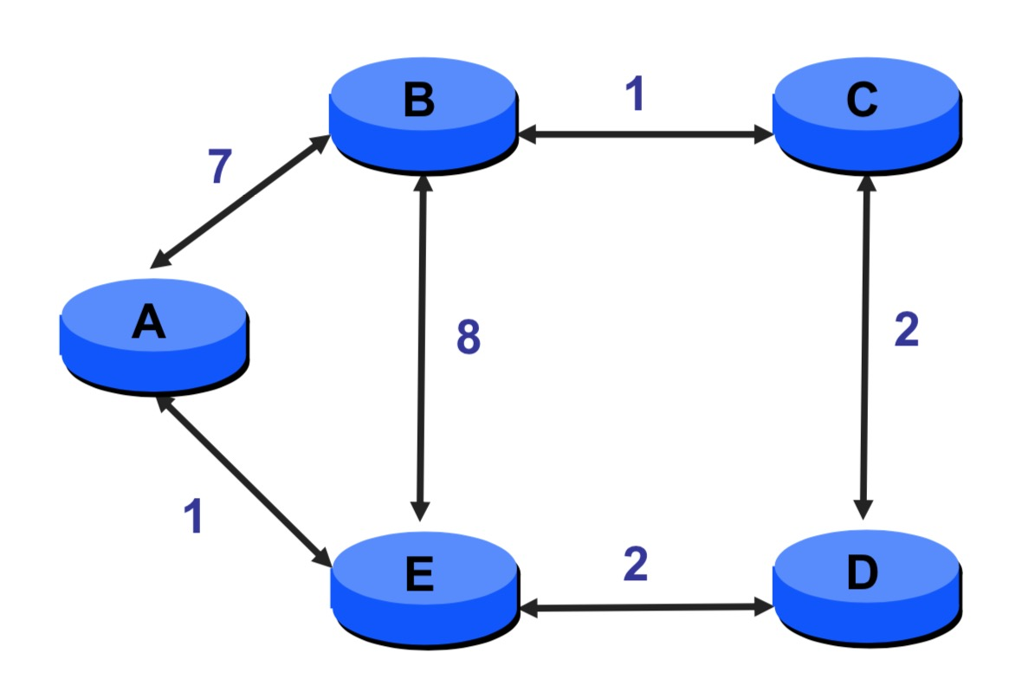
Another Example

Slide 30
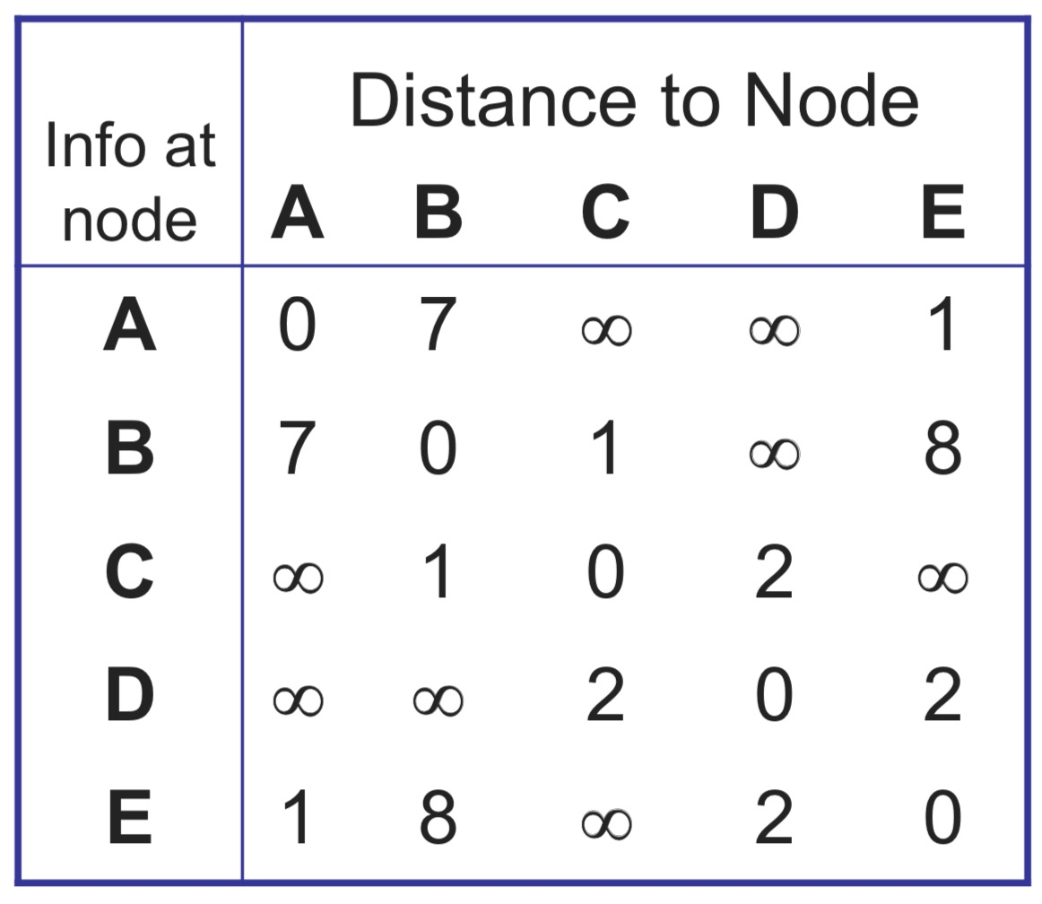
Initial tables
4-30

Slide 32
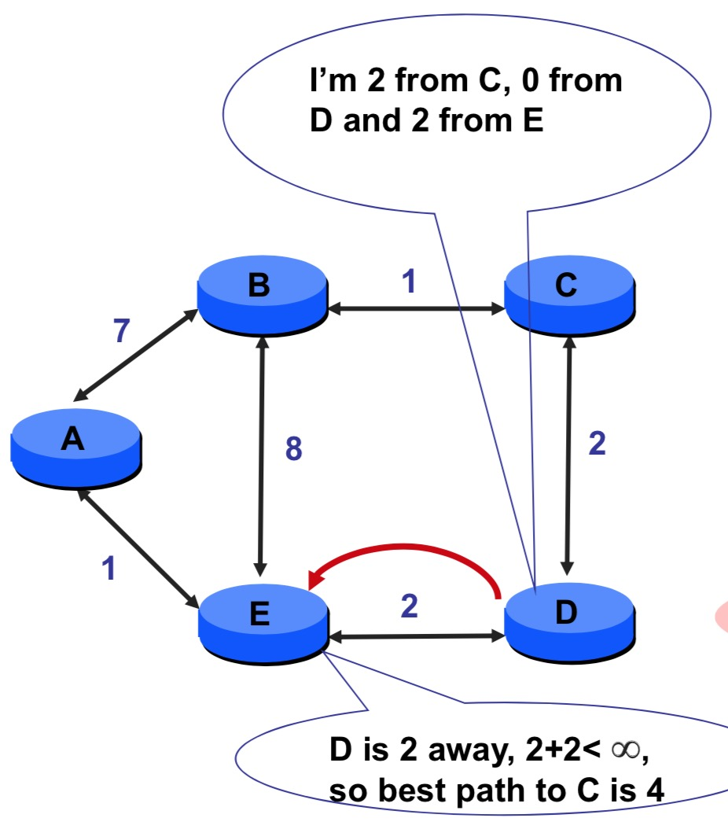
D sends vector to E

Slide 33
D sends vector to E
D
E

Slide 34
D sends vector to E
D
E
4

Slide 35
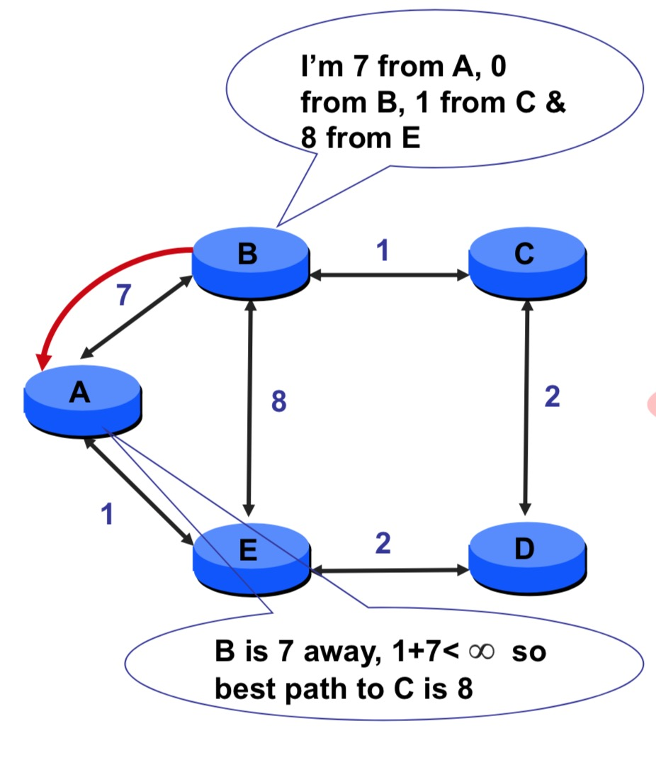
B sends vector to A

Slide 36
B sends vector to A
A
B

Slide 37
B sends vector to A
A
8
B

Slide 38
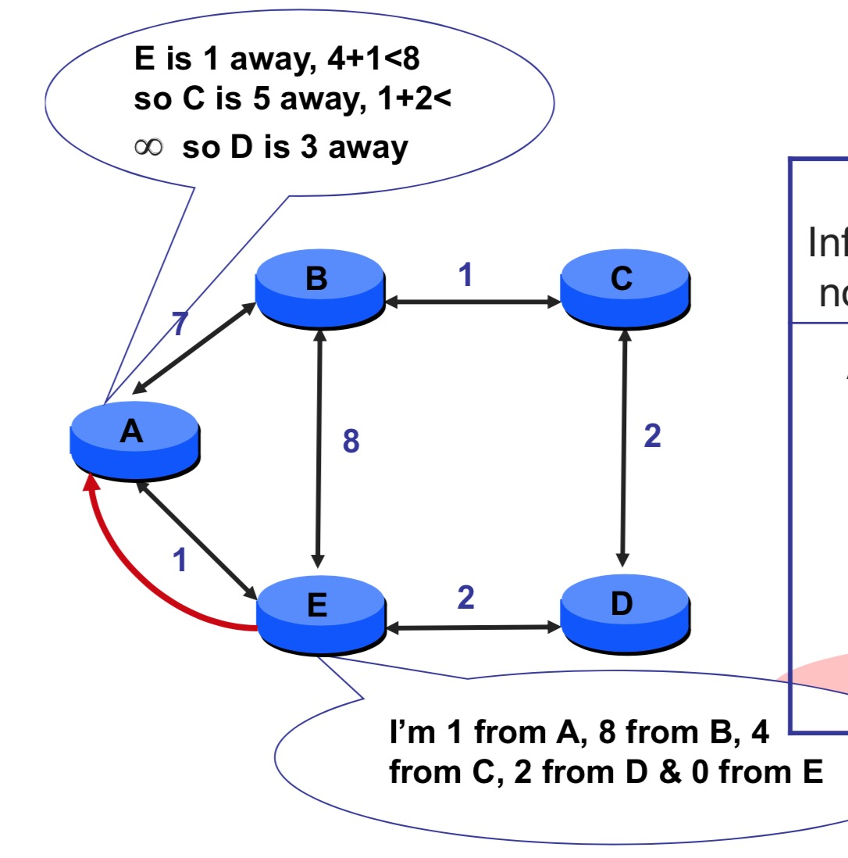
E sends vector to A

Slide 39
When does it end?
The process continues until convergance
What is convergance?

Slide 40
Distance vector: example
DV in a: D_{a}(a)=0
D_{a}(b) = 8
D_{a}(c) = ∞
D_{a}(d) = 1
D_{a}(e) = ∞
D_{a}(f) = ∞
D_{a}(g) = ∞
D_{a}(h) = ∞
D_{a}(i) = ∞
a
b
c
8
1
t=0
1
1
All nodes have distance estimates to nearest neighbors (only)
A few asymmetries:
missing link
larger cost
d
e
f
1
1
All nodes send their local distance vector to their neighbors
1
1
1
g
h
i
1
1

Slide 41
Distance vector example: iteration
a
b
c
8
1
t=1
1
1
All nodes:
receive distance vectors from neighbors
compute their new local distance vector
send their new local distance vector to neighbors
d
e
f
1
1
1
1
1
g
h
i
1
1

Slide 42
Distance vector example: iteration
a
compute
compute
compute
b
c
8
1
t=1
1
1
All nodes:
receive distance vectors from neighbors
compute their new local distance vector
send their new local distance vector to neighbors
d
compute
e
f
compute
compute
1
1
1
1
1
g
h
i
compute
compute
1
compute
1

Slide 43
Distance vector example: iteration
a
b
c
8
1
t=1
1
1
All nodes:
receive distance vectors from neighbors
compute their new local distance vector
send their new local distance vector to neighbors
d
e
f
1
1
1
1
1
g
h
i
1
1

Slide 44
Distance vector example: iteration
a
b
c
8
1
t=2
1
1
All nodes:
receive distance vectors from neighbors
compute their new local distance vector
send their new local distance vector to neighbors
d
e
f
1
1
1
1
1
g
h
i
1
1

Slide 45
Distance vector example: iteration
compute
compute
compute
a
b
c
2
1
t=2
1
1
All nodes:
receive distance vectors from neighbors
compute their new local distance vector
send their new local distance vector to neighbors
d
compute
compute
compute
e
f
1
1
1
1
1
g
compute
compute
compute
h
i
8
1

Slide 46
Distance vector example: iteration
a
b
c
8
1
t=2
1
1
All nodes:
receive distance vectors from neighbors
compute their new local distance vector
send their new local distance vector to neighbors
d
e
f
1
1
1
1
1
g
h
i
1
1

Slide 47
Distance vector example: iteration
…. and so on
Let’s next take a look at the iterative computations at nodes

Slide 48
Distance vector example: computation
DV in b:
DV in c:
  D_{c}(a) = ∞
  D_{c}(b) = 1
  D_{c}(c) = 0
  D_{c}(d) = ∞
  D_{c}(e) = ∞
  D_{c}(f) = ∞
  D_{c}(g) = ∞
  D_{c}(h) = ∞
D_{c}(i) = ∞
  D_{b}(a) = 8
  D_{b}(c) = 1
  D_{b}(d) = ∞
  D_{b}(e) = 1
D_{b}(f) = ∞
D_{b}(g) = ∞
D_{b}(h) = ∞
D_{b}(i) = ∞
DV in a: D_{a}(a)=0
D_{a}(b) = 8
D_{a}(c) = ∞
D_{a}(d) = 1
D_{a}(e) = ∞
D_{a}(f) = ∞
D_{a}(g) = ∞
D_{a}(h) = ∞
D_{a}(i) = ∞
a
b
c
8
1
t=1
1
1
b receives DVs from a, c, e
DV in e:
  D_{e}(a) = ∞
  D_{e}(b) = 1
  D_{e}(c) = ∞
  D_{e}(d) = 1
  D_{e}(e) = 0
  D_{e}(f) = 1
  D_{e}(g) = ∞
  D_{e}(h) = 1
D_{e}(i) = ∞
d
e
f
1
1
1
1
1
g
h
i
1
1

Slide 49
Distance vector example: computation
DV in b:
DV in c:
  D_{c}(a) = ∞
  D_{c}(b) = 1
  D_{c}(c) = 0
  D_{c}(d) = ∞
  D_{c}(e) = ∞
  D_{c}(f) = ∞
  D_{c}(g) = ∞
  D_{c}(h) = ∞
D_{c}(i) = ∞
  D_{b}(a) = 8
  D_{b}(c) = 1
  D_{b}(d) = ∞
  D_{b}(e) = 1
D_{b}(f) = ∞
D_{b}(g) = ∞
D_{b}(h) = ∞
D_{b}(i) = ∞
DV in a: D_{a}(a)=0
D_{a}(b) = 8
D_{a}(c) = ∞
D_{a}(d) = 1
D_{a}(e) = ∞
D_{a}(f) = ∞
D_{a}(g) = ∞
D_{a}(h) = ∞
D_{a}(i) = ∞
a
b
c
b
8
compute
1
t=1
1
1
b receives DVs from a, c, e, computes:
DV in e:
  D_{e}(a) = ∞
  D_{e}(b) = 1
  D_{e}(c) = ∞
  D_{e}(d) = 1
  D_{e}(e) = 0
  D_{e}(f) = 1
  D_{e}(g) = ∞
  D_{e}(h) = 1
D_{e}(i) = ∞
e
d
e
f
1
1
D_{b}(a) = min{c_{b,a}+D_{a}(a), c_{b,c} +D_{c}(a), c_{b,e}+D_{e}(a)} = min{8,∞,∞} = 8
D_{b}(c) = min{c_{b,a}+D_{a}(c), c_{b,c} +D_{c}(c), c _{b,e} +D_{e}(c)} = min{∞,1,∞} = 1
D_{b}(d) = min{c_{b,a}+D_{a}(d), c_{b,c} +D_{c}(d), c _{b,e} +D_{e}(d)} = min{9,2,∞} = 2
1
1
1
D_{b}(e) = min{c_{b,a}+D_{a}(e), c_{b,c} +D_{c}(e), c _{b,e} +D_{e}(e)} = min{∞,∞,1} = 1
DV in b:
D_{b}(f) = min{c_{b,a}+D_{a}(f), c_{b,c} +D_{c}(f), c _{b,e} +D_{e}(f)} = min{∞,∞,2} = 2
D_{b}(g) = min{c_{b,a}+D_{a}(g), c_{b,c} +D_{c}(g), c _{b,e}+D_{e}(g)} = min{∞, ∞, ∞} = ∞
  D_{b}(a) = 8
  D_{b}(c) = 1
  D_{b}(d) = 2
  D_{b}(e) = 1
D_{b}(f) =2
D_{b}(g) = ∞
D_{b}(h) = 2
D_{b}(i) = ∞
g
h
1
i
1
D_{b}(h) = min{c_{b,a}+D_{a}(h), c_{b,c} +D_{c}(h), c _{b,e}+D_{e}(h)} = min{∞, ∞, 2} = 2
D_{b}(i) = min{c_{b,a}+D_{a}(i), c_{b,c} +D_{c}(i), c _{b,e}+D_{e}(i)} = min{∞, ∞, ∞} = ∞

Slide 50
Distance vector example: computation
DV in b:
DV in c:
  D_{c}(a) = ∞
  D_{c}(b) = 1
  D_{c}(c) = 0
  D_{c}(d) = ∞
  D_{c}(e) = ∞
  D_{c}(f) = ∞
  D_{c}(g) = ∞
  D_{c}(h) = ∞
D_{c}(i) = ∞
  D_{b}(a) = 8
  D_{b}(c) = 1
  D_{b}(d) = ∞
  D_{b}(e) = 1
D_{b}(f) = ∞
D_{b}(g) = ∞
D_{b}(h) = ∞
D_{b}(i) = ∞
DV in a: D_{a}(a)=0
D_{a}(b) = 8
D_{a}(c) = ∞
D_{a}(d) = 1
D_{a}(e) = ∞
D_{a}(f) = ∞
D_{a}(g) = ∞
D_{a}(h) = ∞
D_{a}(i) = ∞
a
b
c
8
1
t=1
1
1
c receives DVs from b
DV in e:
  D_{e}(a) = ∞
  D_{e}(b) = 1
  D_{e}(c) = ∞
  D_{e}(d) = 1
  D_{e}(e) = 0
  D_{e}(f) = 1
  D_{e}(g) = ∞
  D_{e}(h) = 1
D_{e}(i) = ∞
d
e
f
1
1
1
1
1
g
h
i
1
1

Slide 51
Distance vector example: computation
DV in b:
DV in c:
  D_{c}(a) = ∞
  D_{c}(b) = 1
  D_{c}(c) = 0
  D_{c}(d) = ∞
  D_{c}(e) = ∞
  D_{c}(f) = ∞
  D_{c}(g) = ∞
  D_{c}(h) = ∞
D_{c}(i) = ∞
  D_{b}(a) = 8
  D_{b}(c) = 1
  D_{b}(d) = ∞
  D_{b}(e) = 1
D_{b}(f) = ∞
D_{b}(g) = ∞
D_{b}(h) = ∞
D_{b}(i) = ∞
a
b
c
1
compute
8
t=1
1
1
c receives DVs from b computes:
d
e
f
D_{c}(a) = min{c_{c,b}+D_{b}(a}} = 1 + 8 = 9
DV in c:
  D_{c}(a) = 9
  D_{c}(b) = 1
  D_{c}(c) = 0
  D_{c}(d) = 2
  D_{c}(e) = ∞
  D_{c}(f) = ∞
  D_{c}(g) = ∞
  D_{c}(h) = ∞
D_{c}(i) = ∞
D_{c}(b) = min{c_{c,b}+D_{b}(b)} = 1 + 0 = 1
D_{c}(d) = min{c_{c,b}+D_{b}(d)} = 1+ ∞ = ∞
D_{c}(e) = min{c_{c,b}+D_{b}(e)} = 1 + 1 = 2
D_{c}(f) = min{c_{c,b}+D_{b}(f)} = 1+ ∞ = ∞
D_{c}(g) = min{c_{c,b}+D_{b}(g)} = 1+ ∞ = ∞
g
h
i
D_{c}(h) = min{c_{bc,b}+D_{b}(h)} = 1+ ∞ = ∞
D_{c}(i) = min{c_{c,b}+D_{b}(i)} = 1+ ∞ = ∞

Slide 52
Distance vector example: computation
DV in b:
  D_{b}(a) = 8
  D_{b}(c) = 1
  D_{b}(d) = ∞
  D_{b}(e) = 1
D_{b}(f) = ∞
D_{b}(g) = ∞
D_{b}(h) = ∞
D_{b}(i) = ∞
DV in e:
  D_{e}(a) = ∞
  D_{e}(b) = 1
  D_{e}(c) = ∞
  D_{e}(d) = 1
  D_{e}(e) = 0
  D_{e}(f) = 1
  D_{e}(g) = ∞
  D_{e}(h) = 1
D_{e}(i) = ∞
DV in d:
  D_{c}(a) = 1
  D_{c}(b) = ∞
  D_{c}(c) = ∞
  D_{c}(d) = 0
  D_{c}(e) = 1
  D_{c}(f) = ∞ D_{c}(g) = 1
  D_{c}(h) = ∞
D_{c}(i) = ∞
a
b
c
8
1
t=1
Q: what is new DV computed in e at t=1?
1
1
e receives DVs from b, d, f, h
d
compute
f
DV in f:
  D_{c}(a) = ∞
  D_{c}(b) = ∞
  D_{c}(c) = ∞
  D_{c}(d) = ∞
  D_{c}(e) = 1
  D_{c}(f) = 0
  D_{c}(g) = ∞
  D_{c}(h) = ∞
D_{c}(i) = 1
e
DV in h:
  D_{c}(a) = ∞
  D_{c}(b) = ∞
  D_{c}(c) = ∞
  D_{c}(d) = ∞
  D_{c}(e) = 1
  D_{c}(f) = ∞
  D_{c}(g) = 1
  D_{c}(h) = 0
D_{c}(i) = 1
1
1
1
1
1
g
h
i
1
1

Slide 53
Distance vector: state information diffusion
Iterative communication, computation steps diffuses information through network:
t=0
c’s state at t=0 is at c only
a
b
c
8
1
c’s state at t=0 has propagated to b, and may influence distance vector computations up to 1 hop away, i.e., at b
t=1
1
1
t=1
t=2
c’s state at t=0 may now influence distance vector computations up to 2 hops away, i.e., at b and now at a, e as well
t=2
d
e
f
1
1
c’s state at t=0 may influence distance vector computations up to 3 hops away, i.e., at b,a,e and now at c,f,h as well
t=3
t=3
1
1
1
c’s state at t=0 may influence distance vector computations up to 4 hops away, i.e., at b,a,e, c, f, h and now at g,i as well
t=4
g
h
i
1
1
t=4
Visualization Distance Vector: https://algorithms.discrete.ma.tum.de/graph-algorithms/spp-bellman-ford/index_en.html

Slide 54
Distance vector: link cost changes
link cost changes:
node detects local link cost change
updates routing info, recalculates local DV
if DV changes, notify neighbors
1
y
4
1
x
z
50
We focus here only on y’s and z’s distance table entries to destination x. c
t₀ : y detects link-cost change, updates its DV, informs its neighbors.
“good news
travels fast”
t₁ : z receives update from y, updates its table, computes new least cost to x , sends its neighbors its DV.
t₂ : y receives z’s update, updates its distance table. y’s least costs do not change, so y does not send a message to z.

Slide 55
Distance vector: link cost changes
60
link cost changes:
Let’s now consider what can happen when a
link cost increases.
Before the link cost changes, D_{y}(x) = 4, D_{y}(z) = 1, D_{z}(y) = 1, and D_{z}(x) = 5.
At time t0, y detects the link-cost change (the cost has changed from 4 to 60). y computes its new minimum-cost path to x to have a cost of
D_{y}(x) = min{c(y,x) + D_{x}(x), c(y,z) + D_{z}(x)} = min{60 + 0, 1 + 5} = 6
y
4
1
x
z
50
But the only information node y has is that its direct cost to x is 60 and that z has last told y that z could get to x with a cost of 5.
with our global view of the network, we can see that this new cost via z is wrong.
Is it really correct?

Slide 56
Distance vector: link cost changes
link cost changes:
Let’s now consider what can happen when a
link cost increases.
So in order to get to x, y would now route through z, fully expecting that z will be able to get to x with a cost of 5.
As of t1 we have a routingloop—in order to get to x, y routes through z, and z routes through y.
A routing loop is like a black hole—a packet destined for x arriving at y or z as of t1 will bounce back and forth between these two nodes forever (or until the forwarding tables are changed).

Slide 57
Distance vector: link cost changes
link cost changes:
Let’s now consider what can happen when a
link cost increases.
2. Since node y has computed a new minimum cost to x, it informs z of its new distance vector at time t1.
3. Sometime after t1, z receives y’s new distance vector, which indicates that y’s minimum cost to x is 6. z computes a new least cost to x
Since z’s least cost to x has increased, it then informs y of its new distance vector at t2.
60
y
4
1
x
z
50
D_{y}(x) = min{c(y,x) + D_{x}(x), c(y,z) + D_{z}(x)} = min{60 + 0, 1 + 5} = 6
D_{z}(x) = min{c(z,x) + D_{x}(x), c(z,y) + D_{y}(x)} = min{50 + 0, 1 + 6} = 7

Slide 58
Distance vector: link cost changes
60
link cost changes:
Let’s now consider what can happen when a
link cost increases.
4. After receiving z’s new distance vector, y determines
5. Sometime after , z receives y’s new distance vector, which indicates that y’s minimum cost to x is 8. z computes a new least cost to x
Since z’s least cost to x has increased, it then informs y of its new distance vector …..
y
4
1
x
z
50
D_{y}(x) = min{c(y,x) + D_{x}(x), c(y,z) + D_{z}(x)} = min{60 + 0, 1 + 7} = 8
D_{z}(x) = min{c(z,x) + D_{x}(x), c(z,y) + D_{y}(x)} = min{50 + 0, 1 + 8} = 9

Slide 59
Distance vector: link cost changes
60
link cost changes:
Let’s now consider what can happen when a
link cost increases.
How long will the process continue?
the loop will persist for 44 iterations (message exchanges between y and z)—until z eventually computes the cost of its path via y to be greater than 50.
At this point, z will (finally!) determine that its least-cost path to x is via its direct connection to x. y will then route to x via z.
y
4
1
x
z
50

Slide 60
Distance vector: count- to-infinity
60
link cost changes:
Let’s now consider what can happen when a
link cost increases.
The result of the bad news about the increase in link cost has indeed traveled slowly!
What would have happened if the link cost c(y, x) had changed from 4 to 10,000 and the cost c(z, x) had been 9,999?
Because of such scenarios, the problem we have seen is sometimes referred to as the count- to-infinity problem.
y
4
1
x
z
50

Slide 61
Distance vector: poisoned reverse
60
poisoned reverse:
If Z routes through Y to get to X :
  Z tells Y its (Z’s) distance to X is infinite
  (so Y won’t route to X via Z)
y
4
1
x
z
50
z will advertise to y that Dz(x) = ∞ (even though z knows Dz(x) = 5 in truth). z will continue telling this little white lie to y as long as it routes to x via y.
Since y believes that z has no path to x, y will never attempt to route to x via z, as long as z continues to route to x via y (and lies about doing so).

Slide 62
Distance vector: poisoned reverse
60
poisoned reverse:
If Z routes through Y to get to X :
  Z tells Y its (Z’s) distance to X is infinite
  (so Y won’t route to X via Z)
y
4
1
x
z
50
As a result of the poisoned reverse, y’s distance table indicates D_{z}(x) = ∞.
When the cost of the (x, y) link changes from 4 to 60 at time t0, y updates its table and continues to route directly to x, albeit at a higher cost of 60, and informs z of its new cost to x, that is, Dy(x) = 60.

Slide 63
Distance vector: poisoned reverse
60
poisoned reverse:
If Z routes through Y to get to X :
  Z tells Y its (Z’s) distance to X is infinite
  (so Y won’t route to X via Z)
y
4
1
x
z
50
After receiving the update at t1, z immediately shifts its route to x to be via the direct (z, x) link at a cost of 50.
Since this is a new least-cost path to x, and since the path no longer passes through y, z now informs y that D_{z}(x) = 50 at t2.

Slide 64
Distance vector: poisoned reverse
60
poisoned reverse:
If Z routes through Y to get to X :
  Z tells Y its (Z’s) distance to X is infinite
  (so Y won’t route to X via Z)
y
4
1
x
z
50
After receiving the update from z, y updates its distance table with Dy(x) = 51.
Also, since z is now on y’s least-cost path to x, y poisons the reverse path from z to x by informing z that D_{y}(x) = ∞ (even though y knows that Dy(x) = 51 in truth).

Slide 65
Distance vector: poisoned reverse
60
poisoned reverse:
If Z routes through Y to get to X :
  Z tells Y its (Z’s) distance to X is infinite
  (so Y won’t route to X via Z)
y
4
1
x
z
50
Does poisoned reverse solve the general count-to-infinity problem?
It does not. Loops involving three or more nodes (rather than simply two immediately neighboring nodes) will not be detected by the poisoned reverse technique.

Slide 66
Distance vector: link cost changes
link cost changes:
node detects local link cost change
“bad news travels slow” – count-to-infinity problem:
60
y
4
1
x
z
50
y sees direct link to x has new cost 60, but z has said it has a path at cost of 5. So y computes “my new cost to x will be 6, via z); notifies z of new cost of 6 to x.
z learns that path to x via y has new cost 6, so z computes “my new cost to x will be 7 via y), notifies y of new cost of 7 to x.
y learns that path to x via z has new cost 7, so y computes “my new cost to x will be 8 via y), notifies z of new cost of 8 to x.
z learns that path to x via y has new cost 8, so z computes “my new cost to x will be 9 via y), notifies y of new cost of 9 to x.
…
see text for solutions. Distributed algorithms are tricky!

Slide 67
Comparison of LS and DV algorithms
message complexity
  LS: n routers, O(n²) messages sent
  DV: exchange between neighbors; convergence time varies
robustness: what happens if router malfunctions, or is compromised?
LS:
  router can advertise incorrect link cost
  each router computes only its own table
DV:
  DV router can advertise incorrect path cost (“I have a really low cost path to everywhere”): black-holing
  each router’s table used by others: error propagate thru network
speed of convergence
LS: O(n²) algorithm, O(n²) messages
  may have oscillations
DV: convergence time varies
  may have routing loops
  count-to-infinity problem
Animation of Dijkstra’s Algorithm: https://www.cs.usfca.edu/~galles/visualization/Dijkstra.html
Distance Vector: https://algorithms.discrete.ma.tum.de/graph-algorithms/spp-bellman-ford/index_en.html
Notes:
In the DV algorithm, each node talks to only its directly connected neigh- bors, but it provides its neighbors with least-cost estimates from itself to all the nodes (that it knows about) in the network. In the LS algorithm, each node talks with all other nodes (via broadcast), but it tells them only the costs of its directly con- nected links.
But an LS node is computing only its own forward- ing tables; other nodes are performing similar calculations for themselves.

Slide 68
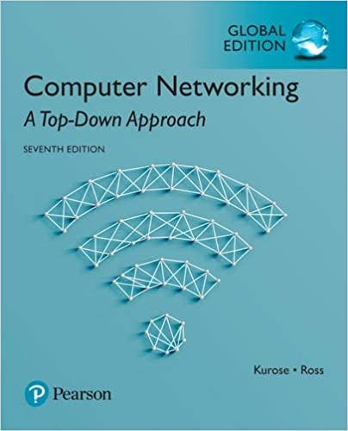

Thank You All
☺
?
A note on the origin of these ppt slides:
All material copyright 1996-2020 J.F Kurose and K.W. Ross, All Rights Reserved
These slides are freely provided by the book authors and it represents a lot of work on their part. We would like to thank J.F Kurose and K.W. Ross.
Network Layer: Control plan: 3-150
Notes:
Section F and G ended

